Slide 1

Statistical Computation Methods for Data Science Unit-V Lecture 4
By
S.U.RAVI KUMAR CHAVALI
Assistant professor of Mathematics
Department of Science and Humanities
Sreenidhi Institute of Science and Technology
Yamnampet, Ghatkesar.
1
Notes:
1

Slide 2
We discuss the following in today’s Lecture
Measurement of Seasonal Component
Deseasonalisation
Measurement of cyclical variations:

Slide 3
There are different methods to measure the seasonal variations.
These are:
Method of simple averages.
Ratio to trend method
Ratio to moving average method
Link relative method.

Slide 4

Method of simple averages

Slide 5

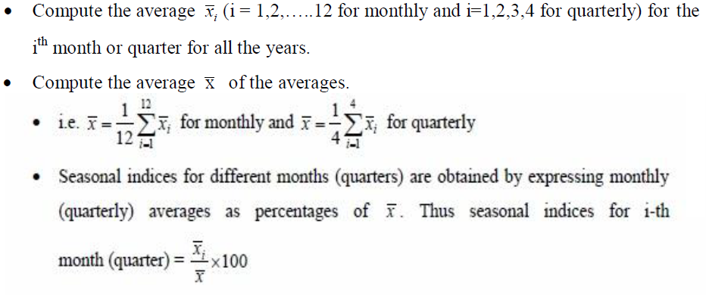

Slide 6



Slide 7



Slide 8
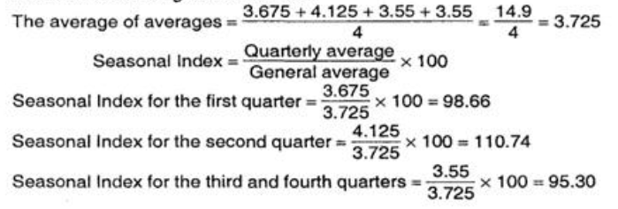

Slide 10



Slide 11
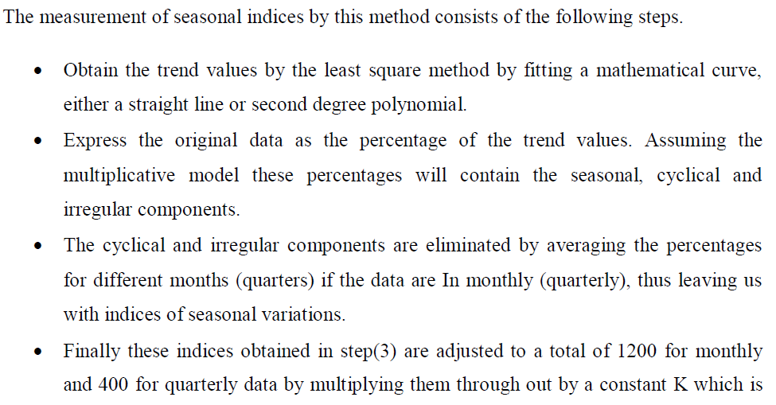

Slide 12


Slide 13
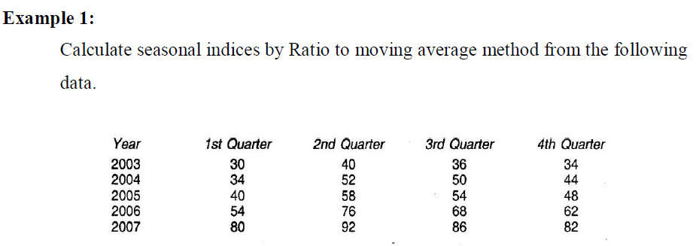

Slide 14
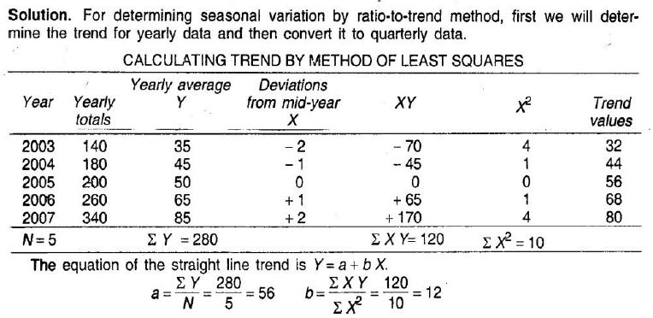


Slide 15
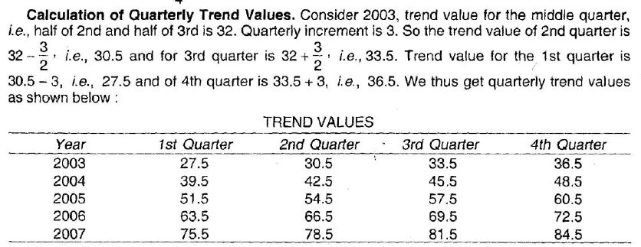

Slide 17
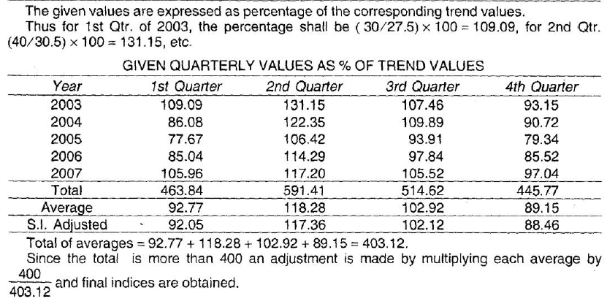

Slide 19
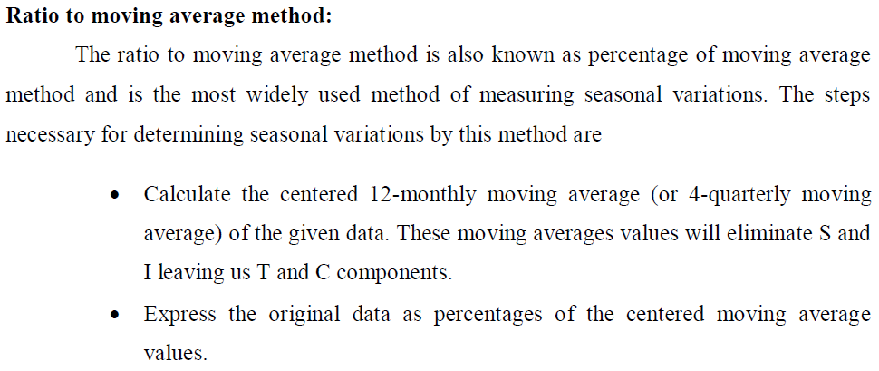

Slide 20

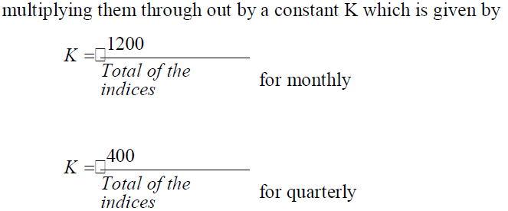

Slide 21


Slide 22
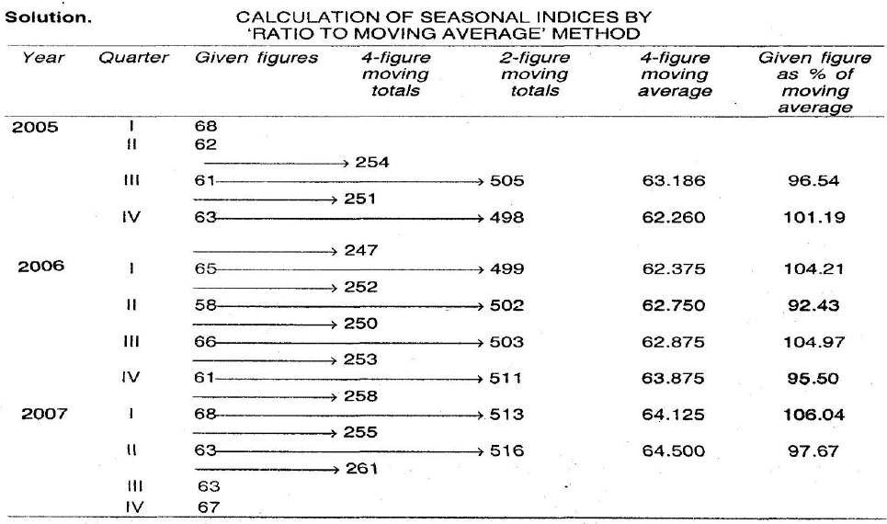

Slide 24
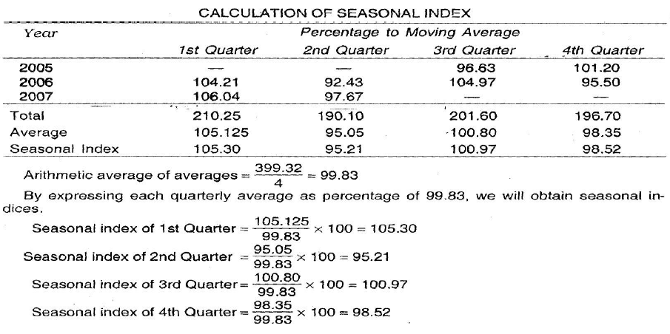

Slide 26
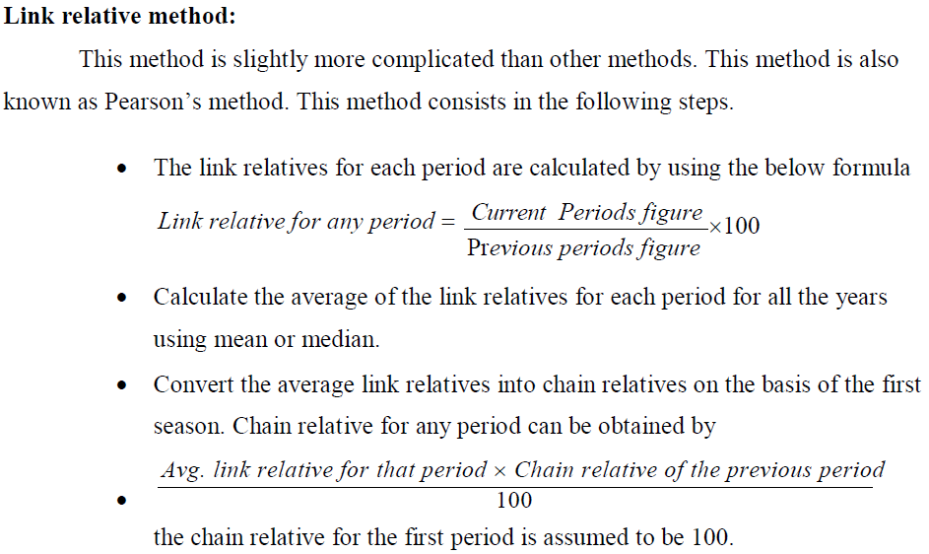

Slide 27
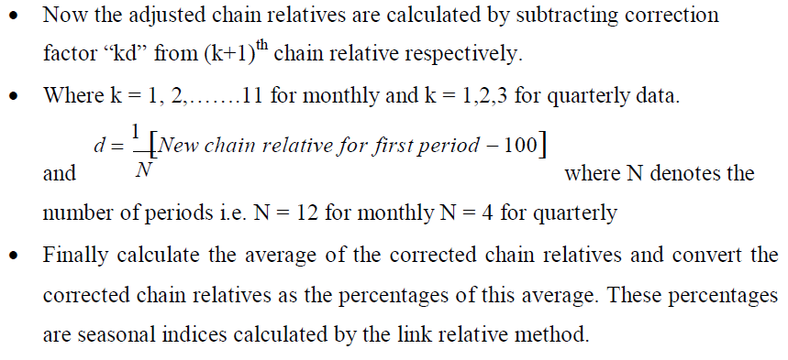

Slide 28


Slide 29


Slide 30
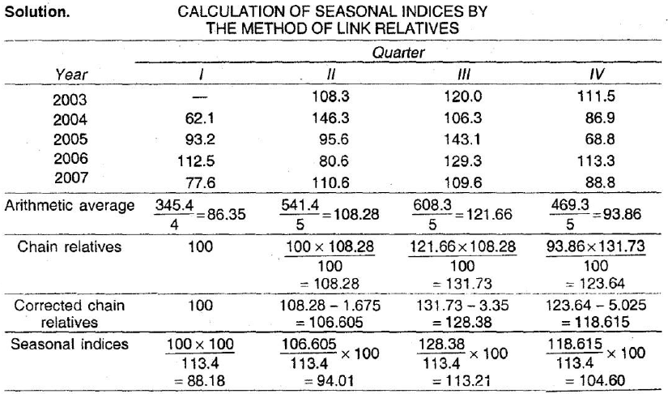

Slide 33


Slide 35


Slide 36
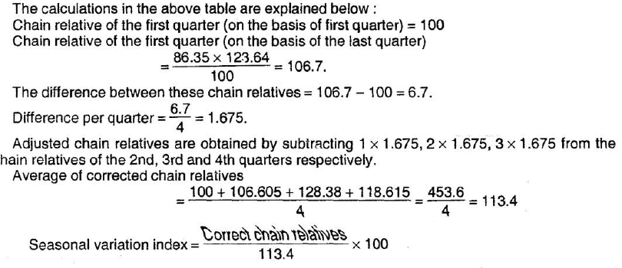

Slide 40
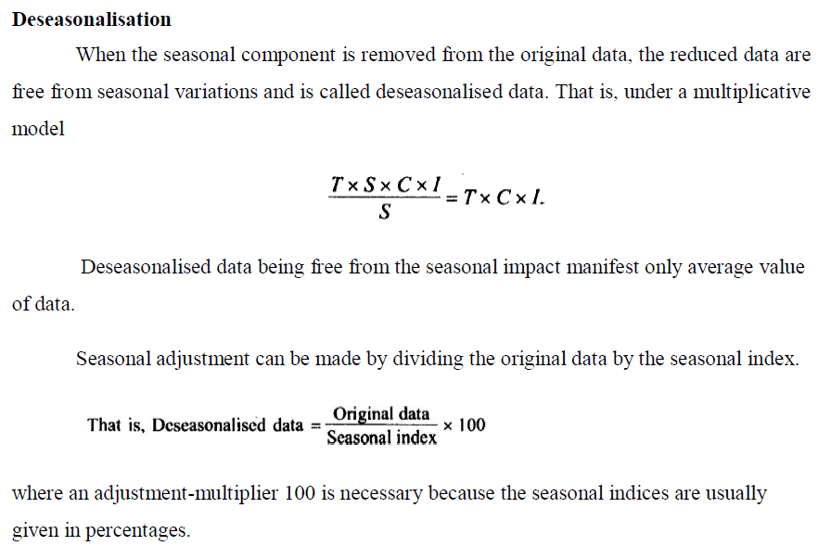

Slide 41
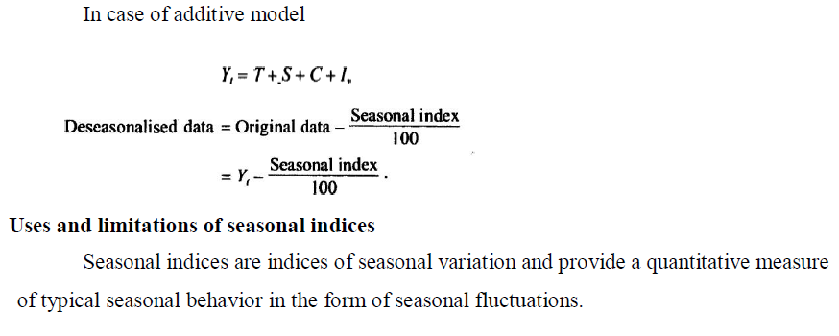

Slide 42
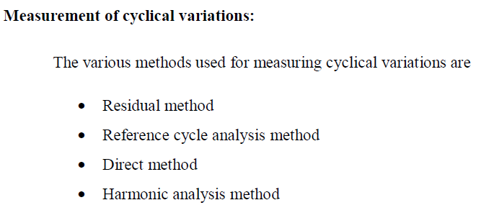

Slide 43
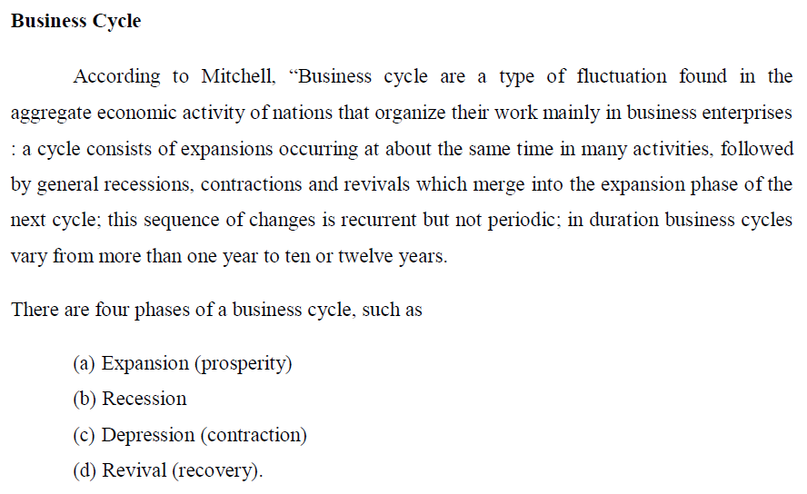

Slide 44
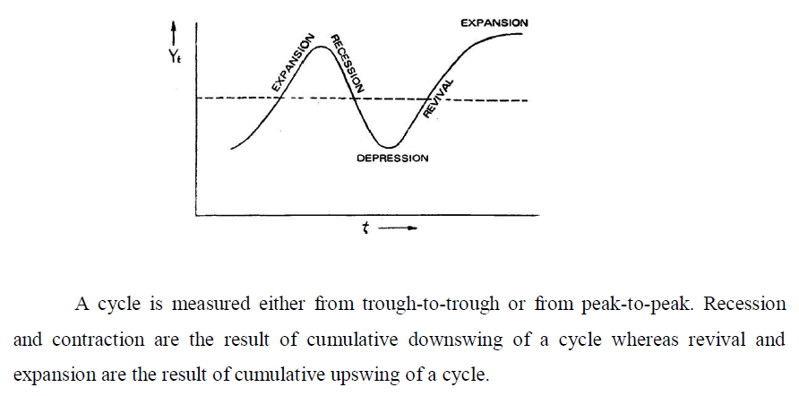

Slide 45
THANK YOU
Notes:
45

